Slide 1





Exoplanet Habitability Assessment System
TEAM MENTOR
PROF. BHAVANA TIPLE
TEAM MEMBERS
PARTH HASE - 1032233204
SHARAL CHALSE - 1032233748
SHRAVANI AHIRRAO - 1032233517
ROHIT PITHANI - 1032233501
SHIVAM PAWAR - 1032233919
ATHARVA SALUNKE - 1032233262

Slide 2


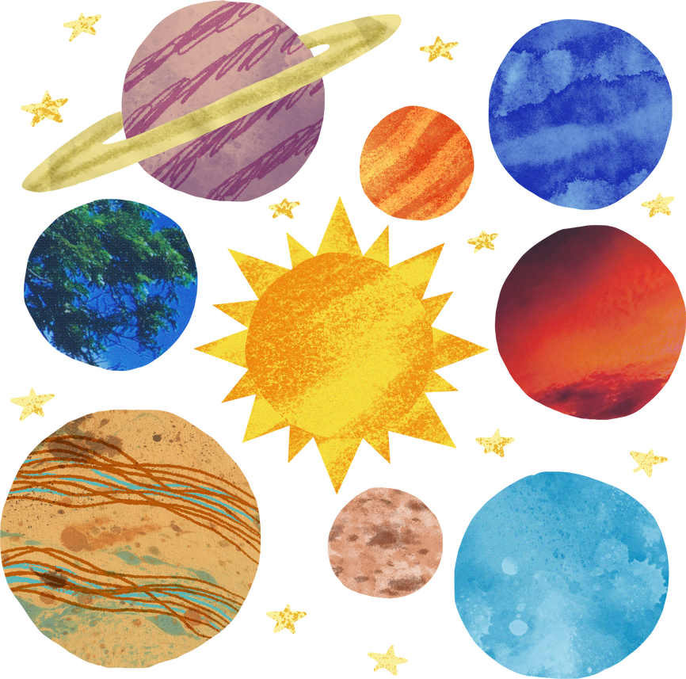
problem statement
Space agencies like NASA, ESA, and ISRO face significant challenges in accurately predicting exoplanet habitability due to scattered and limited astronomical data.
Current detection techniques such as radial velocity, transit photometry, and spectroscopy offer fragmented insights, making it difficult to evaluate an exoplanet’s potential to support life or prioritize candidates for further study.
Moreover, there is a lack of AI-driven models capable of analyzing multiple planetary factors, predicting habitability scores, and simulating terraformability potential.
Our project aims to address this gap by developing an AI-powered Exoplanet Habitability Assessment System. Utilizing machine learning, this system will analyze planetary conditions, assess habitability based on various scientific factors, and provide AI-driven insights.
This innovative approach will assist astronomers, researchers, and space agencies in making well-informed decisions regarding exoplanet exploration and potential colonization.

Slide 3

overview
Our project, AI-Powered Exoplanet Habitability Assessment System, harnesses the power of AI and machine learning to analyze exoplanetary data and predict habitability.
By integrating real-time astronomical data, the system evaluates critical planetary factors such as atmosphere, temperature, radiation levels, and the probability of liquid water.
It provides AI-driven reasoning to explain habitability scores and assesses terraformability potential, offering a groundbreaking approach to exoplanet analysis.
Unlike traditional methods, our system delivers a comprehensive, automated, and scientifically robust assessment, enabling space agencies, researchers, and astronomers to efficiently prioritize exoplanets for further study and potential colonization.
This data-driven approach enhances exploration efforts, making the search for habitable worlds more precise and effective.

Slide 4

solution
Our AI-Powered Exoplanet Habitability Assessment System helps scientists study exoplanets using machine learning (ML) and AI. It collects real-time data from NASA, ESA, TESS, and JWST to analyze key factors like atmosphere, temperature, water presence, radiation, and magnetic field strength.
Using XGBoost, Neural Networks, and Anomaly Detection, the system calculates a habitability score, predicting how likely a planet is to support life. It also includes an AI-driven Terraformability Analysis, which suggests ways to make planets more suitable for humans.
Unlike traditional methods like radial velocity, transit photometry, and spectroscopy, which give limited and scattered data, our system combines all factors into a clear AI-based model. It also has a GPT-based astrophysics explanation engine that provides real-time insights, helping astronomers understand the results.
With this automated and data-driven approach, researchers, space agencies, and private space companies can easily identify and prioritize exoplanets for future exploration, speeding up discoveries and preparing for possible human settlement.

Slide 5
USP (Unique Selling Proposition)
Key Benefits
AI-Driven Habitability Scoring – Uses ML, AI reasoning, and real-time data for precise exoplanet assessment.
Terraformability Simulation – Predicts engineering solutions to make exoplanets habitable.
Real-Time Scientific Reasoning – GPT-powered engine provides deep astrophysical insights.
Multi-Source Data Integration – Combines data from NASA, ESA, JWST, and more for a complete analysis.
Automated & Scalable – Reduces manual efforts, making exoplanet research faster and more efficient.
Accelerates Space Research – Helps identify and prioritize exoplanets for exploration.
Enhances Decision-Making – Delivers AI-driven insights for astronomers and space agencies.
Innovative & Future-Ready – Transforms raw data into actionable habitability predictions.
Supports Terraforming Research – Identifies planets with potential for human habitation.
Scientific & Commercial Impact – Valuable for research institutions, space agencies, and private space firms.

Slide 6
Problem & solution
Problem 1: Time Delay in AI Reasoning in System
Solution 1: Using Gemini 2.0 Flash for Faster AI Response directly in Frontend’s Backend Route.
Pros:
Low Latency: Gemini 2.0 Flash is optimized for quick response times.
Direct Frontend Integration: Eliminates backend delays, reducing request-processing time.
Cons:
Limited Context Handling leading to inaccurate summary generation which may struggle with complex multi-step reasoning.
Cloud Dependency: Requires internet connectivity, so offline reasoning is not possible.

Slide 7
Problem & solution
Solution 2: Building a specific LLM related to our problem statement which will provide accurate response in less time using specific platforms like AWS S3, Google cloud platform GCP.
Pros:
Higher Accuracy: A domain-specific LLM will be fine-tuned on relevant data, ensuring more precise and context-aware responses.
Faster Response Time: Optimized models are smaller and focused, reducing computational load and improving response speed.
Cons:
High Development Cost: Fine-tuning or training an LLM requires significant resources, including high-end GPUs and skilled professionals.
Data Collection Challenges: Gathering high-quality, domain-specific data for training can be time-consuming and expensive.
Limited Generalization: A specialized LLM may perform well on specific queries but struggle with broader or out-of-domain questions.
Maintenance Overhead: Continuous updates and retraining are required to keep the model accurate as information evolves.

Slide 8
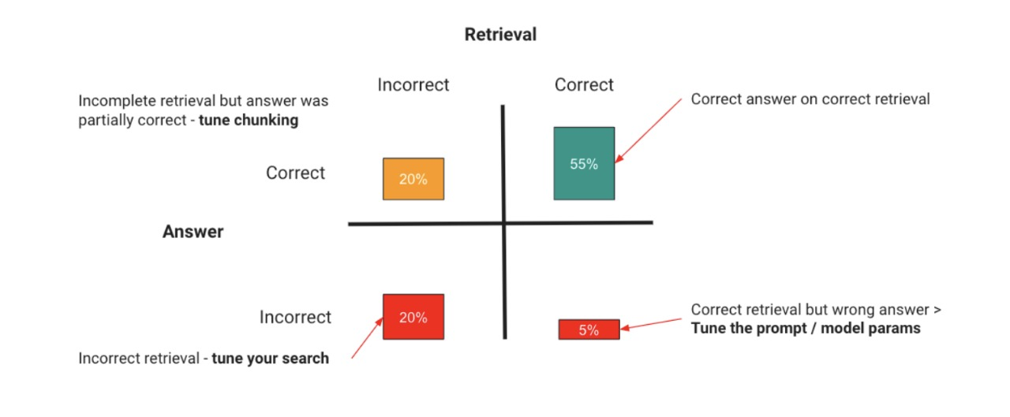


Slide 9
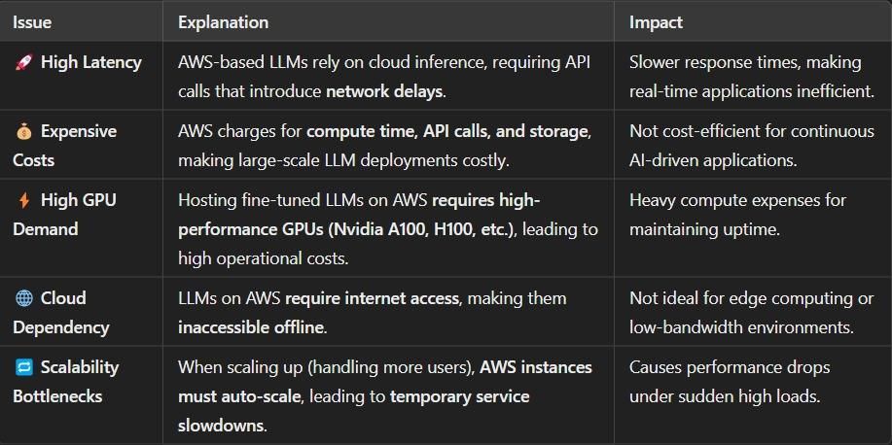

Slide 10
Problem & solution
Problem 2: AI-Generated Exoplanet Images in Frontend
Solution: Using FramerMotion for Dynamic Visual Structure of Exoplanets
Pros:
Customizable & Lightweight: FramerMotion provides real-time rendering and smooth animations.
Lower System Requirements: No need for high-end GPUs like in AI-based image generation.
Better Control Over Visual Accuracy: You can tweak the parameters, colors, and structure manually.
No API Costs: Unlike DALL·E or BioNemo, FramerMotion doesn’t require expensive API calls.
Cons:
Lack of AI-Based Realism: AI-generated images provide natural-looking planets, while FramerMotion is a manual-based visualization.

Slide 11
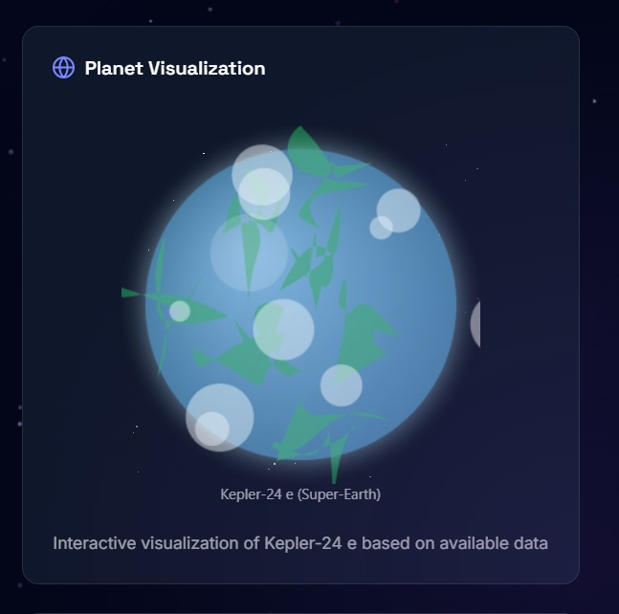
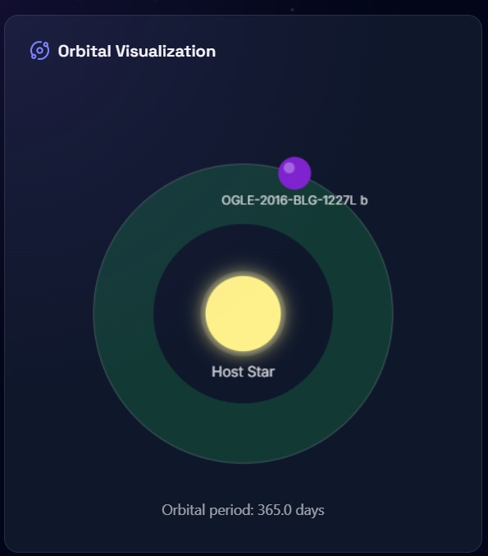

Slide 12

Business Model & Growth Plan
SaaS-Based Exoplanet Analysis:
Our AI-Powered Exoplanet Habitability Assessment System is a cloud-based SaaS platform that allows space agencies, researchers, universities, and private space firms to evaluate exoplanet habitability without needing advanced hardware—making AI-driven research more accessible.
Key Features
Cloud-Based AI Processing – Eliminates the need for costly hardware.
Automated Habitability Analysis – Provides instant AI-driven insights.
Real-Time Data Sync – Integrates live data from NASA, TESS, JWST & ESA.
Scalable & Secure – Supports multiple users efficiently.
Intuitive Dashboard – Easy-to-use for scientists & enthusiasts.
Enterprise API Access – Connects seamlessly with existing databases.
Historical Comparisons – Tracks habitability trends over time.
Growth Strategy & Future Commercialization
🔹 Phase 1 (Years 1-2) – Build partnerships with space agencies & universities; enhance AI precision.
🔹 Phase 2 (Year 3) – Expand to global markets, collaborating with private space firms & institutions.
🔹 Phase 3 (Year 4) – Introduce Terraformability Simulations for advanced habitability insights.
🔹 Phase 4 (Year 5) – Integrate Quantum AI for ultra-fast assessments, setting a new industry benchmark.

Slide 13


THANK
YOU

